Slide 1
Diffuse interface methods
Stephen Millmore
Laboratory for Scientific Computing

Slide 2
Outline
Diffuse interface methods
Seven-equation models
Six-equation models
Five-equation models
Numerical Methods

Slide 3
Outline
Diffuse interface methods
Seven-equation models
Six-equation models
Five-equation models
Numerical Methods

Slide 4
Diffuse interface methods
Unlike ghost ﬂuid methods, diﬀuse interface methods are not a class of numerical technique, but a formulation of the underlying system of equations
The key assumption behind these methods is that each computational cell can contain more than one material
The equations governing the conservation of such a system can be expressed in a thermodynamically consistent manner
This formulation allows for material interactions to be dealt with naturally
Once we have this formulation, the numerical methods we have covered so far can (sort of) be used
So the main challenge in implementing diffuse interface methods is to modify your code's material description (equation of state, flux functions, etc.)

Slide 5
Diffuse interfaces and naming
(Almost) any boundary represented within a single system of equations, on an Eulerian mesh, will suffer from numerical smearing, hence diffuse interface
However, these methods go by many different names, often based on the original application they were developed for
And, unlike sharp interfaces, diffuse interface methods can be used to model both sharp material transitions and genuine transition regions
Sometimes attempts are made to separate these transition models, but since they often use the same underlying mathematical formulations, and only differ through source terms, we shall lump all these methods together
One this is clear though, we do not explicitly model the interface; these methods give an implicit boundary representation

Slide 6
Alternative names
Multi-fluid models – the name originates from the assumption that finite volume methods are just used for computational 'fluid' dynamics
However, the name originated with a specific application in mind, for modelling mixtures of homogeneous gases
Multi-phase models – methods originally designed with two genuinely different phases
However, sometimes two gases or two liquids are described as multi-phase, as are ghost fluid methods
Multi-material methods – a bit more general, at least two gases are genuinely multi-material
Though this term is often used for all multiphysics models

Slide 7
Methods without interfaces
The three "multi-" names, although inconsistently used, do at least make the assumption that there doesn't need to be an interface when we have multiple materials per cell
But, in general, if a system is left to settle, and there is still no visible interface (e.g. a mixture of oxygen and nitrogen molecules), then you could probably use a single equation of state for the entire mixture
Not always, though, two-fluid MHD models electrons and ions separately, and due to their differing charge, there are strong effects between them, but they always form a mixture
In such systems, however, you can model the two components completely separately, due to their very different masses (and also model electric and magnetic fields separately again)
The key complexity in this case comes from source terms

Slide 8
Concepts of a diffuse interface method
The concepts of conservation of total mass, momentum and energy still apply
But we also have mass, momentum and energy to track for each material in our diffuse interface system
Unless we allow for phase change, individual mass of each material will still be conserved
But there will certainly be energy and momentum transfer between materials
These models can be created for arbitrary numbers of materials, but for simplicity, we shall assume there are only two
As a result, each cell could have two density values, two momentum values and two energy values
What is needed to complete the system?

Slide 9
Mixture quantities and total quantities
If the materials did not interact at all, this would be sufficient (but would not be multiphysics)
For a finite volume cell, these two distributions are indistinguishable, we cannot assume knowledge of how material is distributed
But if we say there is a 50-50 mix of materials, are we talking about mass or volume?
And what do we mean by the density of one of these materials?
We know it is mass per unit volume, but what volume? The whole cell, or the equivalent volume occupied by the material?
?

Slide 10

Volume fraction
In these two configurations, we assume that the two materials are in the same thermodynamic state
Equivalent to a moving contact discontinuity
In this case, we have a single pressure across all materials, and since , we need to have each material's density being measured per-volume-occupied
This means that in order to complete this thermodynamic description of the materials, we need to know how much of each material is in the cell
We need knowledge of the volume fraction of each material in the cell

Slide 11



Volume fraction
The standard convention is that any quantity which is per-region-occupied is given an index, e.g. and
We then have per-cell quantities, such as a total density (or total mass); these are given by quantities without an index, e.g.
In order to compute total density, we need to know each material's volume fraction, which is a quantity ranging from 0 to 1
There is no standard symbol for volume fraction, and are commonly used in the literature – in these lectures I shall attempt to use
Since the total mass is just the sum of the individual masses within the volume, it is easy to show that
Note that the two volume fractions are actually a single independent quantity, since they are related through

Slide 12
Conserved quantities
Total mass, and hence total density, must be conserved
And clearly, individual densities are not conserved – these two configurations both have the same and
The individual mass of each material must still be conserved
This implies that if there is no mass transfer, then and are conserved
But what about the other variables?

Slide 13
Other conserved variables
We started with mass and density, because they are easy to visualise and intuitively understand
There are equivalent concepts for the total momentum and the total energy in a cell too
The expression of a total quantity in a cell, in terms of the quantities for individual materials, is a mixture rule
The total density, momentum and energy are volume-weighted averages of the individual material quantities
Do we have the same mixture rule for all our non-conserved variables too?
And we also need to know if quantities such as are also conserved.

Slide 14




Mixture rules
It is easy to show that not all quantities obey a volume weighted average
Consider the total velocity
Note that, as expected,
From this, we see that
The quantities and are mass fractions, and velocity is therefore the mass weighted average of the individual velocities
Various other weightings for total quantities exist

Slide 15
Behaviour of the material properties
The quantities and were conserved because we explicitly stated there was no way to transfer mass between materials (no phase change)
Can we make the same statement about the other quantities?
Consider a domain which is a liquid containing a lot of gas bubbles - if we have a large enough domain, this could be treated as a continuum
If we start moving the liquid, do we expect the bubbles to move?
Transfer of momentum and energy (e.g. kinetic energy in this case) cannot be neglected (assuming we actually want material interaction)
It is also worth noting that one of the advantages of diffuse interface methods is that since they are a natural formulation for phase change or chemical reactions, we may want to drop the assumption that there is no transfer of mass too

Slide 16
Outline
Diffuse interface methods
Seven-equation models
Six-equation models
Five-equation models
Numerical Methods

Slide 17


Do we have enough information?
So far, we have given three conserved variables, and , but seven independent quantities, , and (or )
This is assuming we have equations of state for each material
The key to closing the system of equations is that even though individual density, momentum and energy are not conserved, they are in balance
In other words, the loss of momentum for one material, due to transfer, is the gain in momentum for the other
If we know how to describe this transfer, then we can write seven balance laws for the unknown variables in this system
We can think of this as the "conservation law with source terms" approach, but the source terms might well depend on what any two interacting materials are; they could be purely mechanical, but there might be chemistry or other thermodynamics

Slide 18
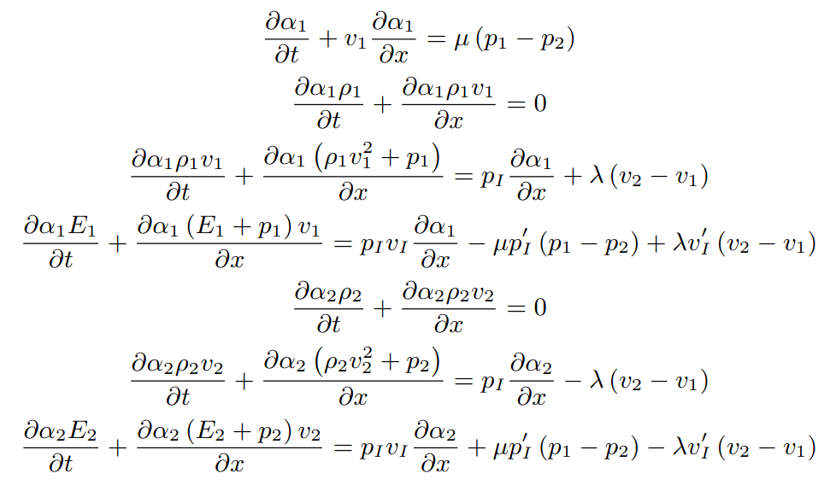
A one-dimensional example
This example assumes only mechanical interaction between materials
Interfacial averages
Different interfacial averages
Relaxation terms
Pressure-induced interface movement
Drag effects
Equilibration effects

Slide 19
The balance terms
There is quite a lot of physics in these balance terms
Interfacial averages – these are quantities which govern the physics of the interface
For example, the effect of high-pressure water on low-pressure air is different to high-pressure air on low-pressure water; this allows for this 'one-sided' interaction
Pressure-induced interface movement – if pressure is higher one side of the interface than the other, the resulting compression will move the interface, and hence alter volume fractions
There is an important feature of diffuse interface methods here – we can have a pressure jump across the interface

Slide 20
Pressure jump
When we considered sharp interfaces, we did technically also allow for a pressure jump, but this was in two cases; a shock wave hits the interface, or a rarefaction passes over it
However, because there was only ever one material per cell, this did not require any special treatment
Now, we have multiple materials in a cell, we have to consider what happens when two materials have two different thermodynamic states
Over time, this will equilibrate, but there is a finite time scale to this behaviour, and whilst this is happening, the pressure difference will cause additional interface motion
This is particularly true when we are modelling a true diffuse transition (the physics of a sharp interface should remain the same)

Slide 21
The balance terms (continued)
In addition to the interface motion, we had two different relaxation effects, drag and thermodynamic equilibration
The drag effects equilibrate velocity; as one material moves through another, it will transfer momentum to the other material, until both are moving at the same velocity
Thermodynamic effects equilibrate pressure; one material will effectively compress the other until they are at the same pressure state
There is no reason the interfacial average quantities are the same for the equilibration processes as for the interface motion, hence the two sets of average terms
The relaxation terms and describe how fast the equilibration process is

Slide 22

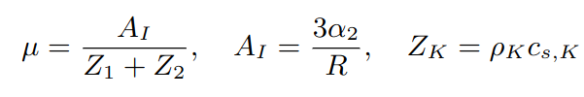
Defining the balance terms
Unfortunately, defining the balance terms is not easy
Because they require knowledge of the physics between two materials, they may require a lot of experimental input, or may be genuinely unknown
This is because, again unfortunately, interface physics is sub-grid cell behaviour – the distribution of the materials in the cell can actually have a substantial effect on these quantities
For example, if we have a gas-liquid mixture, where the liquid (material ) is suspended as bubbles with radius , then we can define
Acoustic impedances
Specific interfacial area

Slide 23
Defining the balance terms
This still does not give us everything; how do we know what radius our bubble have? And why should they be uniform?
And we don't have the interfacial quantities either, and nor is there any single agreed definition for these
It may seem that using this model is more trouble than it is worth
Though this is application dependent – the first formulation was by Baer and Nunziato for granular explosives (granules of explosive surrounded by gas), which also had source terms for detonation chemistry
In this case, at least uniform radius was both appropriate, and measurable

Slide 24
The Baer-Nunziato model
Because of this initial work, seven-equation diffuse interface models are often referred to as Baer-Nunziato-type models
And, despite the sheer number of uncertain parameters, in many cases, simple approximations have been shown to give good models capable of reproducing experimental data
For example, we can often just use the pressure of the 'stiffest' material as the interface pressure (e.g. the liquid in a liquid-gas case)
This formulation can therefore be very powerful if you have a good understanding of how your two materials mix
Now we hopefully know it can describe the mathematics and physics well, how simple is it to solve numerically?

Slide 25

Numerical considerations
We have a system of equations and some source terms; the first thing we would normally want to investigate is hyperbolicity
But here, we have a few additional concerns; although density, momentum and energy equations are written in balance law form, what about volume fraction?
Not only is this equation not in conservation form, we have first derivatives of volume fraction in many of the other equations
Unlike sharp interface methods, this equation does not decouple from the system, and we cannot write the Baer-Nunziato equations in a conservative balance law form
Instead, we must be very careful with numerical methods (which we will not worry about here)

Slide 26
Numerical considerations
We are also not going to worry too much about how we deal with the source terms in the Baer-Nunziato system (because so much is unknown about them)
They will, of course, introduce time step limitations, but there are other challenges too
Relaxation is effectively 'converting' pressure or velocity from one material to another in a thermodynamically consistent manner; this often requires complex root finding problems using the equations of state
We will consider a very specific example later, and one which also includes mass transfer (cavitation)
For now, we analyse the equations in the absence of source terms, but we note that spatial derivatives of the volume fraction cannot be considered source terms here

Slide 27
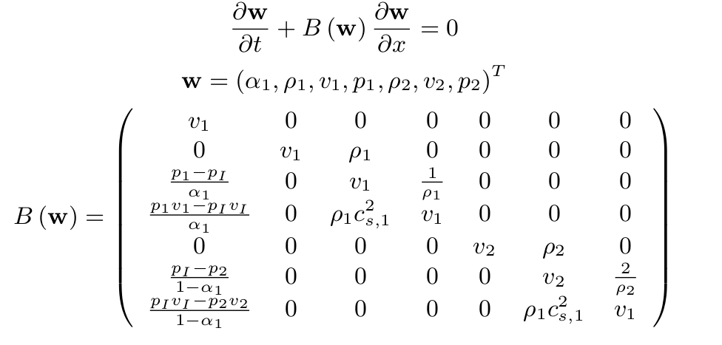
Primitive variable form
Fortunately, the equations are simple to express in primitive variable form, and this means the additional volume fraction derivatives are accounted for

Slide 28
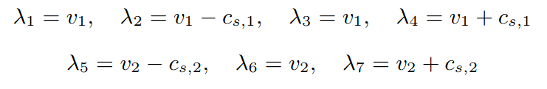
Hyperbolicity and waves
Although the volume fraction terms are a little messy, fortunately they all disappear from the calculation of the eigenvalues, and it is straightforward
We see there are seven waves, with (probably) seven different wave speeds
Though since we don't know the interface velocity, this may be a degenerate wave
However, it is a diagonalisable system, and we can consider characteristic variables
The key difficulty in solving a Baer-Nunziato system, though, is that many numerical methods don't work well due to the lack of conservative form

Slide 29
Solving a Baer-Nunziato system
Numerical methods do exist to solve the Baer-Nunziato equations, they need additional techniques to ensure that oscillations do not develop at sharp features
One such technique is to use standard numerical methods for the conservative parts of the system, and then an alternative “upwind method” to deal with the rest, see, for example, Tokareva and Toro “A flux splitting method for the Baer-Nunziato equations of compressible two-phase flow”
These follow our overall principles that you do not need to modify the methods you have already implemented, simply add to them
However, the additional methods are not always straightforward
Instead we consider an alternative which might make our life easier: do we always need to solve the Baer-Nunziato system for diffuse interface methods?

Slide 30
Outline
Diffuse interface methods
Seven-equation models
Six-equation models
Five-equation models
Numerical Methods

Slide 31
Simplifying the system
Although the Baer-Nunziato is a very powerful, and sometimes essential, multiphysics system, sometimes reasonable physical assumptions allow us to simplify both the system and the methods
This is a matter of timescales – how long does it take for velocity or pressure to relax?
We start with velocity – if one material starts moving, how long until the other material is moving at the same speed
For most diffuse systems, we don’t assume ﬁxed particles of one material suspended in another, but either a true mixture at a molecular scale, or a diffuse representation of a sharp interface
In either of these limits, we can often assume that velocity equilibrium is achieved very fast; faster than the hyperbolic scales of the problem

Slide 32


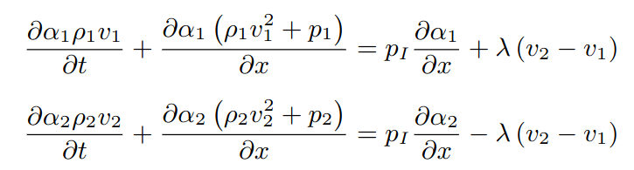
Relaxation time scales
When we can assume velocity equilibrates rapidly, we are assuming an instantaneous relaxation of this quantity
The relaxation parameters and are inversely related to the relaxation timescales
implies no relaxation, the two materials are completely independent of each other

Slide 33


Instantaneous relaxation
Instantaneous relaxation of velocity requires
Mathematically, we still want our equations to be well defined
We can stop the relaxation source term from blowing up if we always have
In other words, we only have one velocity, we always have velocity equilibrium

Slide 34


Velocity equilibrium
Whilst we could try to evolve the two momentum equations separately, things are much easier if we add them together
This gives a single equation for momentum
Sometimes, a total pressure is defined
At this stage, this is notational convenience, not necessarily a definition of a total pressure within a volume

Slide 35
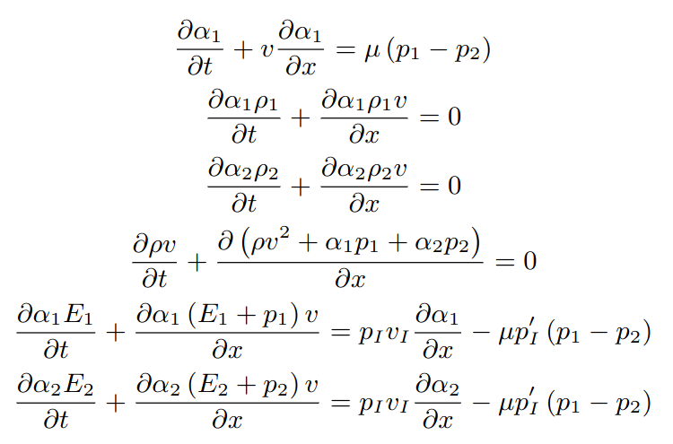
Six-equation formulation
Although we have velocity equilibrium, we may still want to add mass transfer terms, hence we do still include an interface velocity in the equations
In many cases, though, this is simply the single velocity

Slide 36

Is this enough simplicifation?
Unfortunately, the numerical methods for solving this equation are not much simpler than they were for the full Baer-Nunziato system
There are, in fact, many different ways of formulating a six-equation system, and the way it is expressed is often dependent on the numerical method being used
We shall revisit this model, however, when we consider cavitation
For now, we make another assumption, which again assumes we have a sharp material interface, not one material in suspension
Because pressure is transmitted from one material to another in this setup, we can assume pressure equilibrates instantaneously, i.e.
This means we have

Slide 37
Outline
Diffuse interface methods
Seven-equation models
Six-equation models
Five-equation models
Numerical Methods

Slide 38
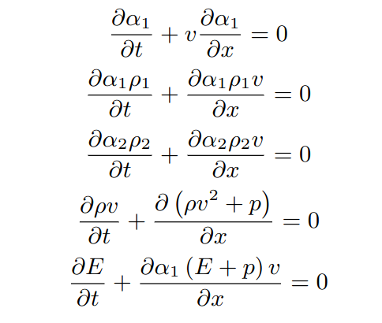
Five-equation formulation
All source terms now cancel out when we add the two energy equations together
We are now assuming no mass transfer – the interface velocity is the material velocity

Slide 39
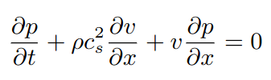
Is this a good model to use?
The five-equation model allows us to get rid of all source terms, and associated time step (and other calculation) issues with these terms
We only have one non-conservative equation; this doesn't immediately improve overall conservation properties of the system, but we shall discuss this more later
Numerical methods are also significantly easier to implement
But is the system hyperbolic?
Each equation is something we have used to compute a primitive variable form
This included pressure, with the equation
But what is this term?

Slide 40
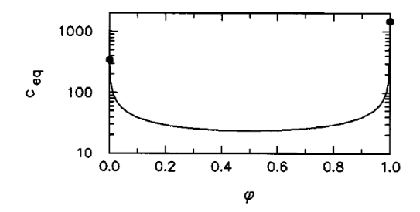

Sound speed of a mixture
The sound speed of a mixture is a well-studied quantity
Wood's textbook (1930) gives a mixture speed for air and water as
The sound speed of a mixture can be lower than that of either component
Equilibrium sound speed
Volume fraction of water

Slide 41
Sound speed of a mixture
What do we mean by equilibrium sound speed?
This considers an equilibrium state in which two phases are at the same pressure and temperature and are fully mixed within a control volume
Is this true if we are using a diﬀuse interface model to represent a sharp interface?
Here we expect a sudden transition from one material to another - the acoustic speed across this volume would be much closer to some form of average of the two states
One of the (seemingly major) disadvantages of the simpliﬁed diﬀuse interface equations is that sound speed is now underdetermined
It can be shown that using the expression above causes oscillations at an interface

Slide 42
What do we need sound speed for?
We have only really seen two uses of sound speed:
Calculating eigenvalues and hyperbolicity
Calculating the maximum wave speed
If we can define a thermodynamically reasonable quantity as a mixture of known physical variables that also ensures the hyperbolicity of the system, we know we are solving a suitable set of equations for density, momentum and energy
If this does not adversely affect time step calculations too, that would help
This is an additional concept for mixture quantities - mathematically averaged quantities that do not permit thermodynamic violation and allow a stable solution despite the underdetermined sound speed
In this case, we don't need to know the individual quantities, just their total value

Slide 43
Sound speed and hyperbolicity
We now need to consider how a mixture sound speed is defined for the 5-equation model, and, at the same time, consider how we ensure we are solving a hyperbolic system
We are looking at a specific 5-equation model, originally described (in more detail) by Allaire, Clerc and Kokh, “A Five-Equation Model for the Simulation of Interfaces between Compressible Fluids” and as a result, this model is often called the Allaire model within the group here
Even within this paper, alternative forms of the equation are considered, e.g. temperature equilibrium, rather than pressure equilibrium
In order to identify a mixture sound speed, we attempt to identify a primitive variable form of the 5-equation model

Slide 44
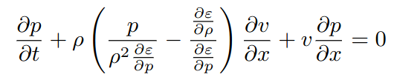
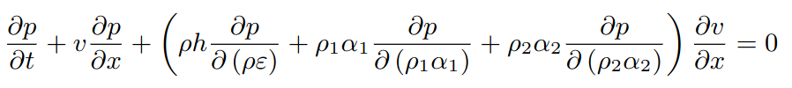

Primitive variable form of the 5-equation model
Much like for the Euler equations, identifying the primitive variable forms for the momentum and the two density equations (as well as the volume fraction) are straightforward
It is the energy equation which causes us trouble, recall for the Euler equations, we managed to rewrite the energy equation in terms of derivatives of pressure, giving
We can do the same thing for the 5-equation model (see Allaire et al. for more detail) and we will get
Mixture specific enthalpy:
Enthalpy:

Slide 45

Primitive variable form of the 5-equation model
This can be made to look like the primitive variable form for the Euler equations if we define
At the moment, this is really just a quantity, which we can compute, which we are calling because of how the equations look if we do this
If we are able to use this as a sound speed, we are then assuming that this quantity is greater than zero, something which depends on derivatives of the equation of state
Potentially, the hyperbolicity of a system of equations might depend on the materials you are using (though not in this case)

Slide 46
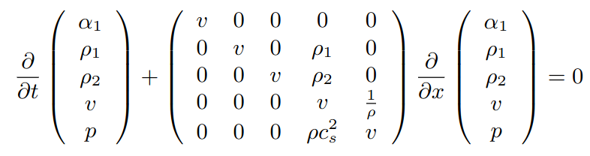
Hyperbolicity of the 5-equation model
Once again, in primitive form, the eigenvalues are very easy to compute (and somewhat familiar)
Even if we didn't call that quantity, the calculation would be just as easy, though it would take a little longer to write down
So, provided exists, we have a hyperbolic system, and now we know this, we can spend some time looking at this quantity

Slide 47
Mixture sound speed
Before we start, we need to decide how we are going to describe out total pressure quantity; what are we going to consider as independent variables
It may initially seem that we have five independent variables in our pressure equation
But, in our 5-equation system, we only have five total independent variables, and momentum (or velocity hasn't appeared here)
In fact, we can always write total pressure as a function of four independent variables, e.g.

Slide 48
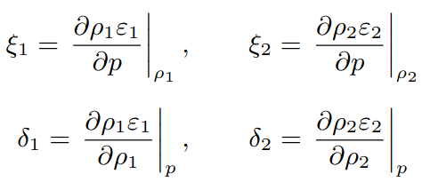
Mixture sound speed
This definition does at least give us a very strong hint as to what variables we use:
We then define a couple of quantities
These are relatively straightforward derivatives of the equation of state, so this makes our derivation neater

Slide 49

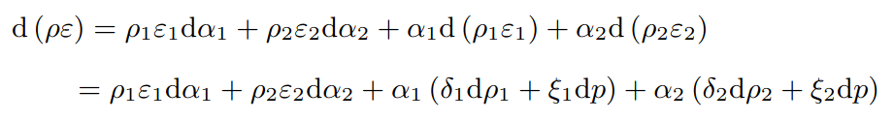
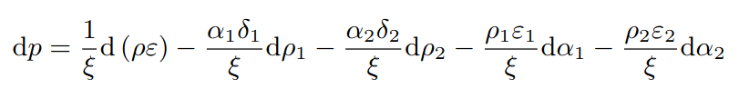

Mixture sound speed
Now we start our derivation by considering changes in internal energy
We use the product rule on this
And then rearrange for pressure
Where we define

Slide 50




Mixture sound speed
We keep simplifying this term, using and
If we compare this to our original definition for , we see that the advantage here is that now the derivatives are very easy to compute

Slide 51



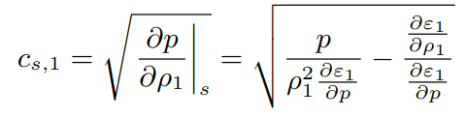

Mixture sound speed
We how have
From our definition of mixture specific enthalpy, we have
Giving
We then use the definition of enthalpy, , and the definition of sound speed, to find

Slide 52

Mixture sound speed
Eventually, we end up being able to write our mixture sound speed in terms of the individual material sound speeds
In other words, the thing we treated as a mixture sound speed is indeed a weighted average of the two material sound speeds
It seems unlikely we could have guessed this weighting though

Slide 53
Outline
Diffuse interface methods
Seven-equation models
Six-equation models
Five-equation models
Numerical Methods

Slide 54
Numerical methods for the 5-equation model
In order to make sure the treatment of the non-conservative part of the equations doesn’t give us problems, we need to be careful with our numerical methods
Part of the popularity of the 5-equation system, though, is though the methods need care, they are not actually difficult, nor unfamiliar, and they don't have any timestep issues
We need three things:
An HLLC solver, with no special corrections or consistency concerns for these equations (other approximate solvers could be used)
A primitive-variable MUSCL-Hancock solver (second order only)
A volume fraction equation which looks like a balance law, with some appropriate source term treatment

Slide 55


HLLC for the 5-equation system
Although there is nothing too surprising about the HLLC solver for this system, we still have a few new terms to consider
Volume fraction only jumps across the material interface under a sharp interface assumption, therefore, unsurprisingly, we have
We also need an HLLC state for each of the density terms, which, given the result above, is also only a minor adjustment
The momentum and energy intermediate states do not change at all, and the wave speed estimates now use the mixture sound speed

Slide 56




Numerical treatment of the volume fraction
We consider this before dealing with the primitive-variable MUSCL solver, since once we have a volume fraction update, we can immediately implement a first-order method
First we express the equation in a balance law-like manner
We can then use a Riemann problem-based method to get, using our HLLC solver, to get
Then we have a source term update step specific to the system
The update step uses the initial volume fraction

Slide 57
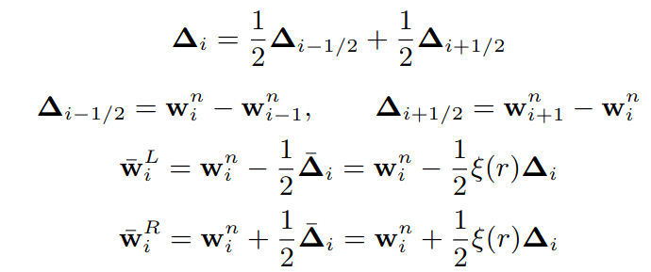
Primitive-variable MUSCL-Hancock scheme
Although we didn't mention it at the time, there is more than one way of using a MUSCL-Hancock scheme – the name relates to the concept of reconstruction, half-timestep update and Godunov solve
The primitive-variable scheme performs the reconstruction and half-timestep update on the primitive variables
The limiters are unchanged, but the limiting variable might change – a standard choice is to limit each variable on itself

Slide 58
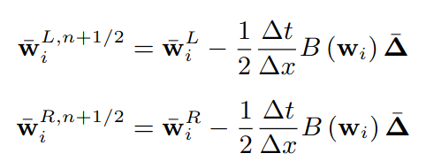

Primitive-variable MUSCL-Hancock scheme
Once we have our reconstructed states, we perform a half-timestep update
We use the primitive variable form, where we have the derivative
The primitive variable matrix is calculated using cell-centred values
Although this is not normally a good form for evolving nonlinear systems, this is a local update, for which we have ensured a suitably smooth reconstruction
Finally, we convert the updated variables to conservative ones, and use these in the Godunov step

Slide 59

Is this everything?
The five-equation system we have introduced is a useful diffuse interface method for many physical systems
It is even possible to compute a physically meaningful temperature (provided you have complete equations of state for your two materials)
Perhaps the main assumption that could need to be relaxed is the assumption that when we apply a force to a volume, both components ‘get pushed out of the way’ at the same speed
In other words, each material in a cell is equally compressible
This assumption holds for material interfaces, but will not be true for all material mixtures

Slide 60
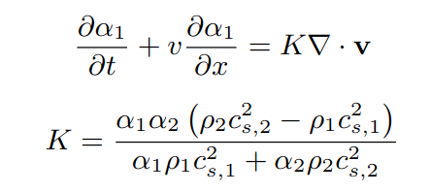
Compaction
Compressing one material in a volume more than another is known as compaction
For example, in a water-air mixture, if the pressure on the edges of of a volume increases, we would expect more compression of the air than the water
In other words, the volume fraction of water should increase as a result of pressure changes, not just advection with velocity
Additional numerical treatments may be needed for the stable evolution of this source term

Slide 61
Further models
We have introduced a few of the most important diffuse interface models, many other formulations exist
These include single-density models
Some of these allow for closure by evolution of equation of state parameters, i.e. still have at least five equations
However, they are designed with specific equations of state in mind (and, generally, two materials with comparable density)
There are also models which do only solve four equations – similar to the one we introduced in the first lecture
In order to achieve stability, a correction step is required - a (non-conservative) step to remove the oscillations we demonstrated with this simple system

Slide 62
Some notes on conservation
We have now introduced two types of multiphysics model, both have the same undesirable property – they are not conservative
We have previously said that non-conservative methods are guaranteed to get the position of shock waves wrong - why have we stopped worrying about this?
In fact, for practical applications of many diffuse interface systems, extra work is needed to deal with shock waves, sometimes evolving additional variables to "fix" the solution
This is particularly true for material transitions – for material interfaces, we typically get away with non-conservative methods

Slide 63
Some notes on conservation – sharp interfaces
For sharp interface methods, the numerical methods for solving the individual phases are still conservative
And provided the level set function remains smooth, we do not get errors here either
The fact that there can only be one material in a computational cell is what causes mass gains and losses, as the interfacce moves
Effectively, the conservation errors are a result of slightly changing the original problem, somewhat equivalent to altering one of the initial states in a Riemann problem
We will still get a thermodynamically reasonable solution, with the correct shock speeds for this new case, it just won’t be solution to the problem we started with
It is clear that this becomes less of a problem with resolution

Slide 64
Some notes on conservation – diffuse interfaces
Diffuse interface methods evolve a non-conservative system, they genuinely do have the risk of producing incorrect shock speeds
We have said that we need to choose numerical methods carefully, we shall use the five-equation source term-free model as an example
Here, only the volume fraction is evolved using a non-conservative method
For most of the domain, we either have or – in these regions, the evolution equation for volume fraction does nothing and we avoid introducing convergence errors
Numerical methods are then selected considering an isolated contact discontinuity
They must ensure that in a situation with constant velocity, but changing density and volume fraction, this velocity remains constant

Slide 65
Some notes on conservation – diffuse interfaces
This choice of numerical method deals with all behaviour away from an interface and continuous behaviour and contact discontinuities at an interface
Although we cannot do anything about the method’s convergence issues with shock waves, what we have done is made sure that these errors only impact a very small region of the computational domain
For a few cells across the interface, there may be errors in shock speed, but these will be small enough not to be noticeable in the overall solution
Additionally, as resolution increases, the interface width decreases, so these errors do converge away
Techniques to sharpen a diffuse interface, such as the Tangent of Hyperbola INterface Capturing (THINC) method, which help further minimise these errors
Provided we choose the correct numerical method, we can successfully cope with the conservation issues for diffuse interface methods

